Slide 1
Draft BUDGET
FISCAL YEAR 2025-2026
March 27, 2025
Tyler salcido, executive officer

Slide 2
PURPOSE OF DRAFT BUDGET
As required by the Cortese-Knox-Hertzberg Act, LAFCo must adopt an annual budget
Adopt preliminary budget by May 1, final by June 15
Ensures operational funding for the next fiscal year
Two budget scenarios for consideration

Slide 3
BUDGET OVERVIEW
Total Budget: $906,442
Increase: $35,199 (4.04%) from FY2024-2025
Two scenarios for funding:
- Scenario 1: Increase Cities/County contributions by 4.04%
- Scenario 2: Keep contributions flat, use reserves

Slide 4
REVENUE BREAKDOWN
Contributions from Cities: $348,841(Scenario 1), $335,295 (Scenario 2)
Contribution from County: $348,841 (Scenario 1), $335,295 (Scenario 2)
LAFCo Fees $38,000
Rental Income $51,288
Interest Income: $18,000

Slide 5
USE OF RESERVES
Scenario 1: Uses $101,472 reserves
- Ending Balance $572,194
Emergency Reserves: $500,000
Unassigned Reserves: $ 72,194
Scenario 2: Uses $128,564 reserves
Ending Balance $545,102
Emergency Reserves: $500,000
Unassigned Reserves: $ 45,102

Slide 6
EXPENDITURES OVERVIEW
Salaries: $434,099
Employee Benefits: $226,544
Communications: $1,200
Liability & Property Insurance: $24,533
Maintenance – Equip: $6,000
Memberships: $6,159

Slide 7
EXPENDITURES OVERVIEW Cont.
Office Supplies: $8,000
Electronics $12,000
Software & Licenses: $7,000
Legal Services: $30,000
Audit & Payroll Services: $23,000
Data Processing/Network: $30,138

Slide 8
EXPENDITURES OVERVIEW Cont.
GIS/CAED: $12,000
Equipment Leases/Rent: $4,092
Misc. Expenses: $1,000
Travel: $27,976
In County: $250
Out of County: $27,726

Slide 9
EXPENDITURES OVERVIEW Cont.
Capital Outlay: $0
Repairs & Maint. – Ongoing Expenses: $20,000
Repairs & Maint. – Remodel: $0
Utilities: $23,100

Slide 10
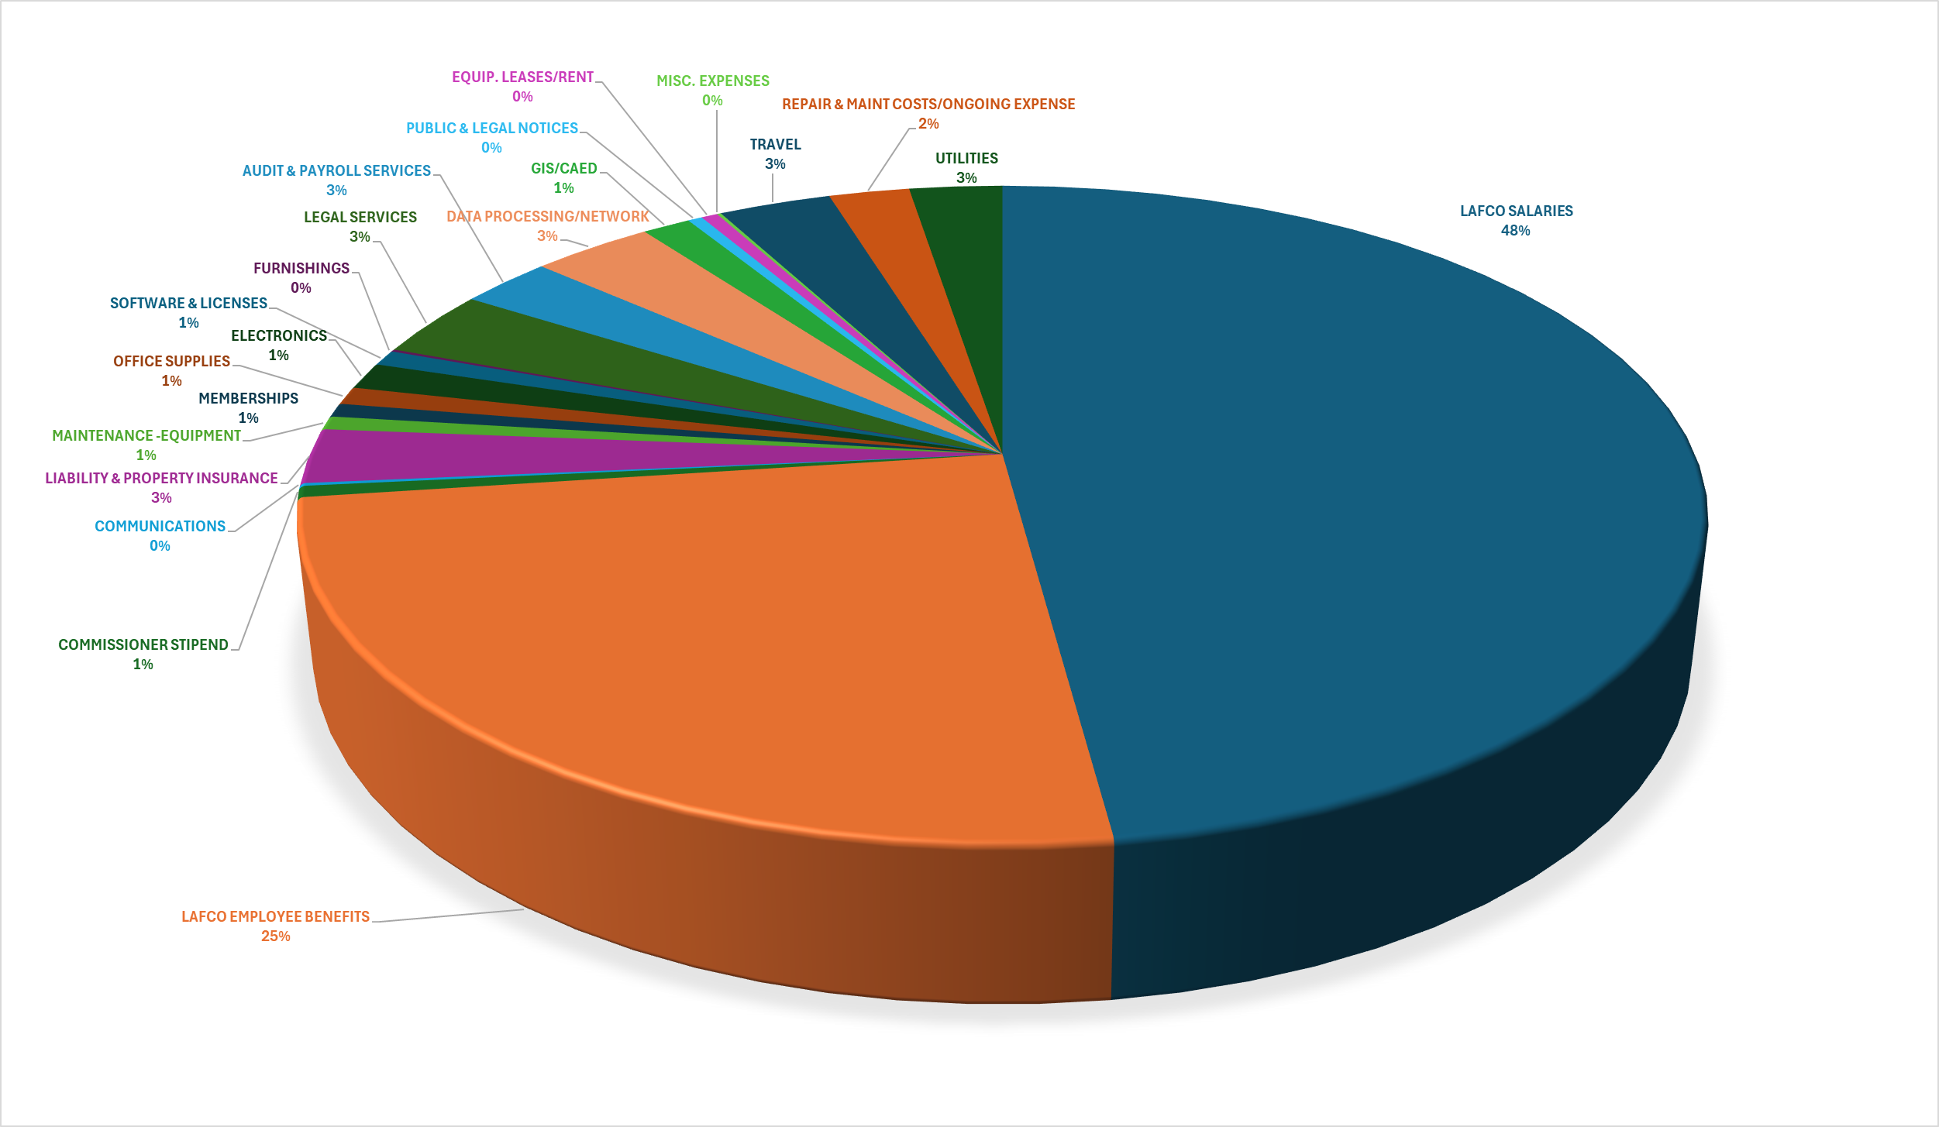
FY2025-2026 LAFCO EXPENDITURES
SALARIES/BENEFITS 73%

Slide 11
BUDGET SCENARIO FINANCIAL TRADE-OFFS
Scenario 1
Scenario 2

Slide 12
BUDGET SCENARIO FINANCIAL TRADE-OFFS
Scenario 1: Moderate use of reserves, maintains higher balance for future flexibility.
Scenario 2: Keeps agency contributions flat, reduces reserve balance, potential future risks.

Slide 13
COMMISSION OPTIONS
Option #1: Approve & adopt the draft budget for FY2025-2026 as presented in Scenario 1.
Option #2: Approve & adopt the draft budget for FY2025-2026 as presented in Scenario 2.
Option #3: Approve & adopt the draft budget for FY2025-2026 as amended by the Commission.

Slide 14
EO RECOMMENDATION
Conduct public hearing, consider feedback
Adopt FY2025-2026 draft budget based on preferred scenario:
Scenario 1: 4.04% increase in contributions
Scenario 2: Flat contributions, increased reserve use

Slide 15
Questions or Comments

